Slide 1
Surveillance Cam
NoirTech

Slide 2
Proposal
Camera with ability to move in 2 dimensions
Remote operation
Take snapshots and record video
Store media to device then to the cloud
Affordable alternative

Slide 3
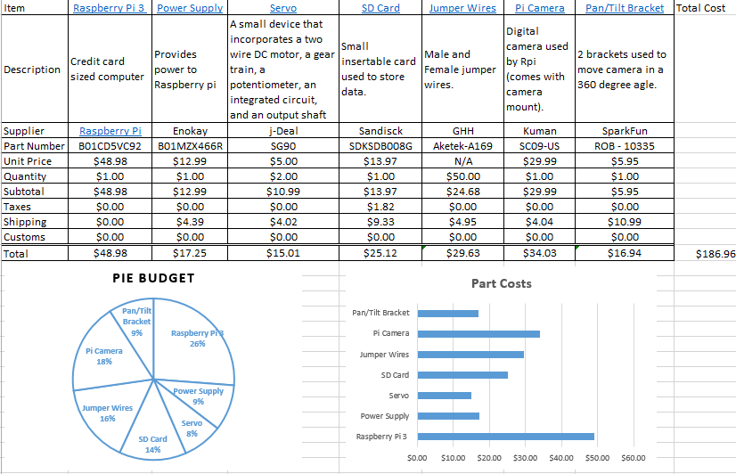
Budget
Raspberry Pi 3
2x servos
Pi Camera
Jumper wires
Pan/Tilt Bracket
Budget: $150
Original cost: $186.96
Final Cost: $122.25

Slide 4
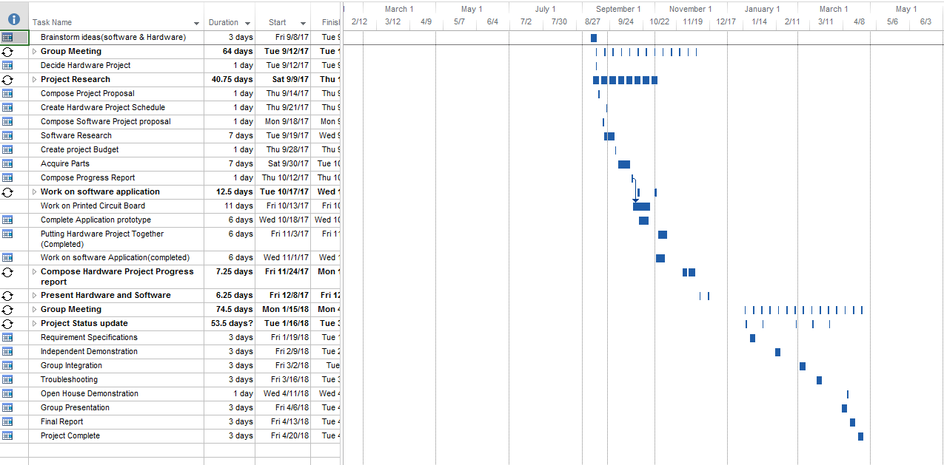
schedule
Proposal
Group meetings
Project research
Hardware research
Software research
Acquiring parts
Assembly
Troubleshooting

Slide 5
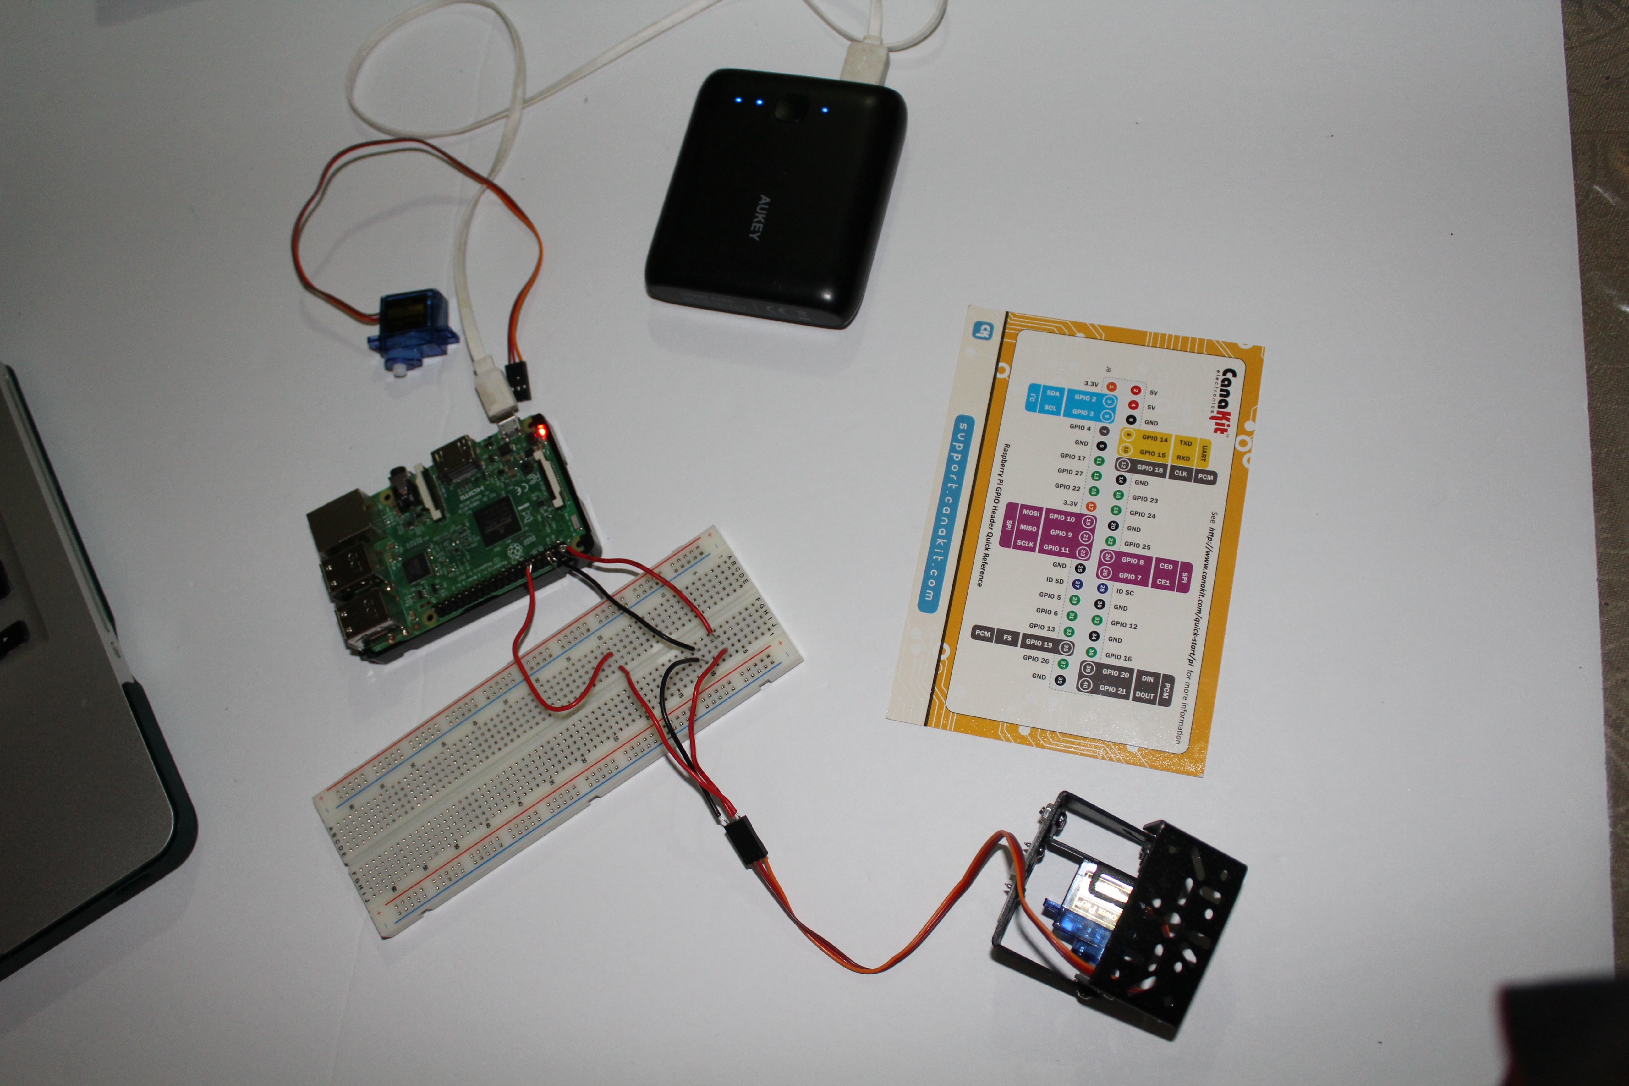
Surveillance Cam Demonstration

Slide 6
Course Knowledge
Pulse width modulation
Html
PHP
Python
Unix
Networking
SQL Database

